Slide 1
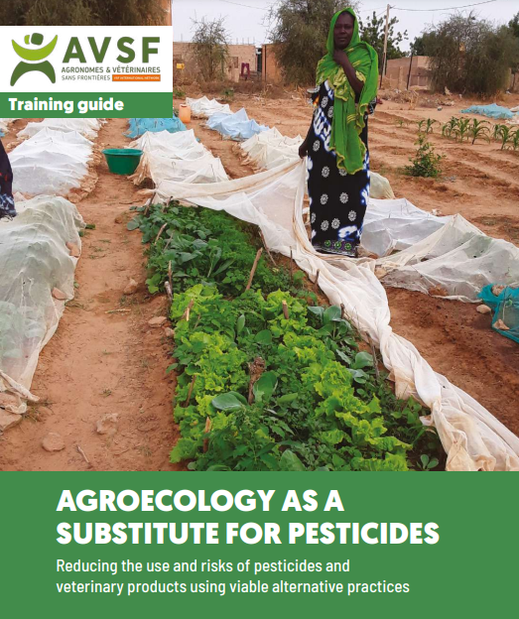
Introduction on AVSF Training guide

Slide 2
Why this guide?
Elaborated by “Alterpestimed” AVSF working group since 2019
To train Avsf teams and partners on these topics as part of “one health” approach
Key elements for diagnosing the use and application of pesticides and veterinary products
Raising awareness on the risks associated with these uses
Illustrate the diversity of agroecological alternatives (give priority to options accessible to smallholder farms with few resources)
Toolbox to adapt training materials to the context/target group → guide to be used by technicians and Farmers organization managers
Target for training: mixed groups of farmers, Farmers organization managers, field technicians (decision-makers, local elected officials and public service agents including health).
Notes:
The ALTERPESTIMED working group is:
A joint will of the CA, employees and members for more systematic action in the face of pesticide and veterinary product risks
A mixed employee/professional volunteer group formed since 20193
Area of action:
Training on pesticide risks and alternatives
Supporting/developing the topic in AVSF projects
Advocacy, lobbying

Slide 3
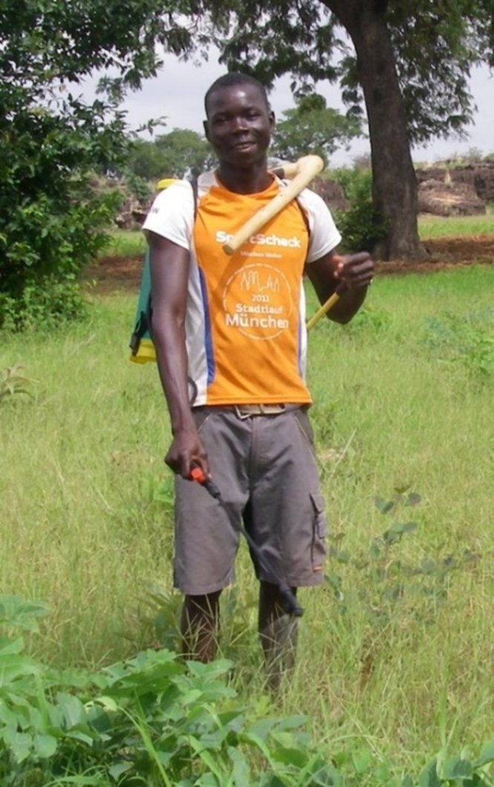
Structure of the guide
A glossary including many definitions essential for understanding the content of the modules
Introduction : objectives and how to use the guide
A few references on the use of pesticides and certain veterinary products in many countries: a situation that is more alarming every day
The 6 modules
The strategies that can be defined following the training
12 annexes

Slide 4
How to use this guide and design training sessions?
“Simple” training of groups of 20 to 30 farmers and technicians
Training of trainers
Self-training of technicians and farmers advisers
Facilitated access to the content of the guide to allow the development and adaptation of training materials:
Creative Commons License: CC BY-NC-SA
Downloadable modules (Word versions with illustrations; ppt presentations)
Training coordinated by AVSF or in support of partners (GIZ, IRAM and CCFD, etc.)
Try to address the issues of pesticides and veterinary products in a joint and complementary manner
→Training as a tool for implementing the ‘One Health’ approach and as a lever for Agroecological Transitions

Slide 5
Objectives of the 6 modules of the guide
Module 1 – Preliminary participatory diagnostics
Identify the main problems leading to the use of pesticides in a given territory and the alternatives already known by farmers.
Module 2 : Prevention of pesticides risks
→ Prevent and limit the risks related to pesticide use and management of their packaging.
Module 3 : Promotion of alternatives to pesticides based on agroecology
→ Identify bioaggressors, prevent their development and propose alternatives
Module 4 : Herbicides reduction
→ Propose improvements in agricultural mechanization to manage weeds
Module 5 : Improving the use of veterinary products
→ Preventing the risks associated with these uses and recommending breeding practices that allow a reduction in these products in line with the “One Health” approach.
Module 6 : Information and mobilization of citizens
(1) the application and reinforcement of national laws concerning pesticides;
(2) compliance with international and regional conventions; (3) support for the implementation of alternative agroecological solutions.

Slide 6
Training courses carried out
8 Training courses carried out to date and approximately 350 people trained including: dont :
A hundred farmers
250 technicians and agronomists in plant production, veterinarians and animal health agents
More than 25 partners (FOs, NGOs, Research, Networks, etc…)

Slide 7
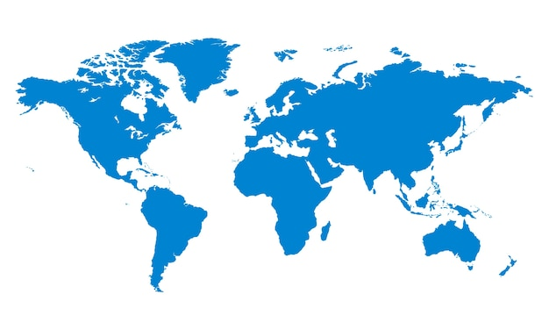
Training & expériences sharing in 7 countries
(2021 -2024)
GUINEE CONAKRY
- Septembre 2023
- Financement IRAM CCFD FPFD
- 40 responsables paysans, 30 techniciens
- formation et sensibilisation d’après résultats d’enquête IRAM , conception de documents de vulgarisation - Modules 1, 2 et 3
FRANCE
- Septembre 2022
- Financement majoritairement GRET
- 22 formés, 15 GRET (10 de terrain) , 5 GTALTPM (2 salariés AVSF) , 1 IRAM
- Modules 1 à 6
MADAGASCAR
SANUVA
- Octobre 2022
- Financement: 1/2 Projet SANUVA, ½ AVSF CPP (ARC) + GIZ (billet Valentin)
- 30 personnes, majoritairement équipes projet + quelques institutionnels et 1 Cirad, pas d’OP
- Modules 1 à 5
PROSOL GIZ
- Novembre 2022 et Mai 2023
- Financement GIZ ProSol
- 2022 : Equipe Eco concult gérant le prosol, institutionnels, qqs chercheurs
- 2023 : 30 personnes de 4 ONG partenaires de ProSol
- appuis généraux en Agroécologie et réduction usage des pesticides
EQUATEUR
- Octobre 2023
- Financement AVSF CPP
- 32/35 formés , qqs paysans, agros , vetos, 3 péruviens, 4 colombiens
- Modules 1 à 6 (sauf 4)
MALI
- Octobre 2021
- Financement Projet FAIR SAHEL
- 32 formés (9 femmes) dont 2/3 de chercheurs et Responsables paysans
- Modules 1 à 4
COTE D’IVOIRE
- Octobre 2021
- Financement AVSF RCI et AFD CPP
- 25 formés dont 80% partenaires et OP
- Modules 1 à 4
SENEGAL
- Février 2022
- Financement Projet THIELLAL
- 39 formés : majorité AVSF
- Modules 1 à 5

Slide 8
Perspectives
Identify and strengthen the skills of key people on the Alterpestimed theme in the countries or major regions of cooperation
Multiply the training effort by relying on these key people :
In response to requests from partners
In projects with this ‘One Health’ component in these objectives and funding for the training of trainers
Improve access and enrich the training guide, if possible in partnership with research institutes :
Enrich modules with more examples and viable alternatives
Deepen agroecological alternatives (examples: preparation method, conditions of use and effectiveness of bio-products based on micro-organisms; local preparation and diffusion of parasitoids, etc.)

