Slide 1
Module 1: Participatory preliminary assessments
V. Beauval - 15-01-2021

Slide 2
Module 1 - To be able to carry out participatory village diagnoses in order to understand the main problems leading to the use of pesticides, how they are managed and the agroecological alternatives already known to farmers.
This module comprises 4 themes:
Theme 1: Identify the main problems of crop pests, animal diseases, weeds, etc. in the villages from which the trainees come.
Theme 2: Find out about the use of synthetic pesticides and veterinary products in these villages and identify where they are purchased and sources of advice.
Theme 3: Identifying pesticide application methods, the type of body protection used, packaging management, human and animal accidents and their frequency.
Theme 4: Identify the agro-ecological and non-chemical alternatives used by people in these villages to care for their crops and animals, and gather opinions on their relevance and the constraints to their wider dissemination. More broadly, take advantage of local knowledge to devise new approaches based on solutions that exist in nature.

Slide 3
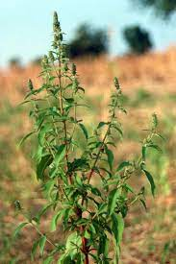
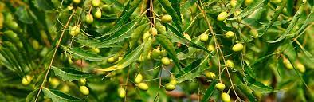
Starting from reality, with the close involvement of farmers, will make it possible to design more practical training courses and to highlight possible synergies between farmers' knowledge and scientific knowledge.
Example observed in Kita (Mali) in 2019 during trials of natural insecticides on cotton: A group of farmers from one village tested a cocktail of natural products that appeared to be just as effective as the one proposed by the Avsf technical team (neem oil or hyptis spicigera?).
The agrarian diagnostics often carried out prior to the projects implemented could include a collection of information concerning the 4 themes of this module.
In terms of training, the survey phases could alternate with the classroom phases (for example, study of a theme in the morning in the villages, then sharing of the information collected and debate in the classroom in the afternoon).

Slide 4
Several appendices to the guide will help trainers and farmers to carry out these participatory diagnoses
Appendix 2 contains two guides for village surveys on pesticide management and alternatives.
Annex 3 is a summary of the surveys carried out at the end of 2018 by AVSF on pesticide management methods in 3 villages in the Kita district in Mali.
Appendix 4 is a guide to gathering information on natural preparations used in villages for crop production.
Appendix 5 is a guide to ethnoveterinary practices.
Appendix 6 lists the studies on ethnoveterinary practices carried out as part of AVSF activities.

