Slide 1
Module 2: Pesticide risk prevention

Slide 2
Module 2 - Educational aim: To be able to prevent and limit the risks associated with the use of pesticides and the management of their packaging.
Teaching guide: For this module, which should be based on the participants' practices, the survey phases in the villages and the classroom work phases can alternate.
This module comprises 5 themes:
Theme 1: Identifying the forms of pesticide toxicity for humans and the environment. Knowing the meaning of the pictograms on labels. Identify the active ingredients used in villages when they are classified as CMR (carcinogenic, mutagenic and reprotoxic). Be familiar with the most dangerous active substances banned by international conventions.
Theme 2: Understanding the main ways in which pesticides penetrate living organisms and how they evolve along food chains. From this, deduce the priorities in terms of personal protection, how and where products are stored and how their packaging is managed.

Slide 3
Module 2: Pesticide risk prevention
Theme 3: Identifying the body protection equipment available in the region, with its benefits, limitations and even the risks presented by certain equipment under farming and tropical conditions. Identifying ways of facilitating farmers' access to certain equipment.
Theme 4: When attacks by insects, diseases, etc. are serious and there are no effective alternative solutions yet, identify the least toxic pesticides and use them more effectively by reducing the risks and adjusting the doses appropriately.
Theme 5: List village practices in terms of managing pesticide packaging. Identify improvements that can be made, in partnership or otherwise, with input sellers, Farmers Organizations and village and communal authorities who are aware of these issues.

Slide 4
Module 2: Pesticide risk prevention - Forms of toxicity
Theme 1: Identifying the ways in which pesticides are toxic to humans and the environment. Knowing the meaning of the pictograms on labels. Identify the active ingredients used in villages when they are classified as CMR (carcinogenic, mutagenic and reprotoxic). Be familiar with the most dangerous active substances banned by international conventions.
Pesticide comes from the Latin cida meaning to kill and the English pest meaning harmful. Chemical or natural pesticides are therefore by definition toxic products for certain living organisms. They include insecticides, fungicides, herbicides and ....
A distinction is made between the immediate effects of pesticides on humans and the environment, their delayed effects and possible cocktail effects (see next slide).
The risk of toxicity from "co-formulants" must also be taken into account.
Never buy a pesticide that has not been approved by the national or regional health authorities (for example, the Comité Sahélien des Pesticides = CSP).

Slide 5
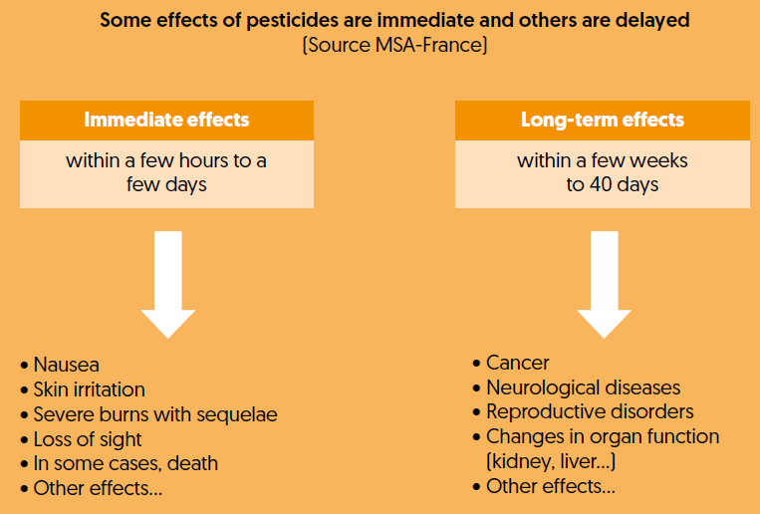
Module 2: Preventing the risks of pesticides - The different types of toxic effects
Cocktail effect (source INSERM, ttps://www.inserm.fr/information-en-sante/)
Every day, we are exposed to a wide range of compounds such as pesticides and medicines,
endocrine disruptors, etc... Toxicologists used to study them separately. They have discovered that this approach is inadequate. When combined, even at low doses, the harmful effects of certain molecules can be amplified. And some combinations can produce unexpectedly deleterious effects...

Slide 6
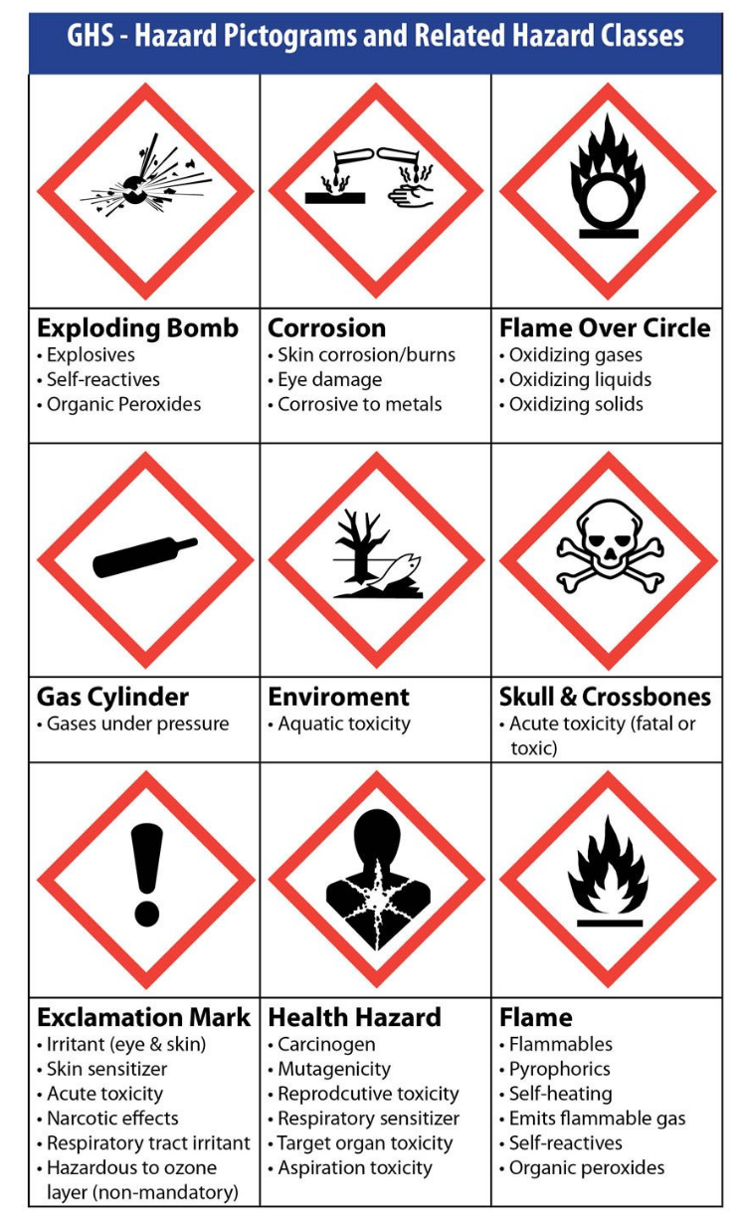

Module 2: Pesticide risk prevention - Old and new pictograms
Old pictograms
New pictograms

Slide 7
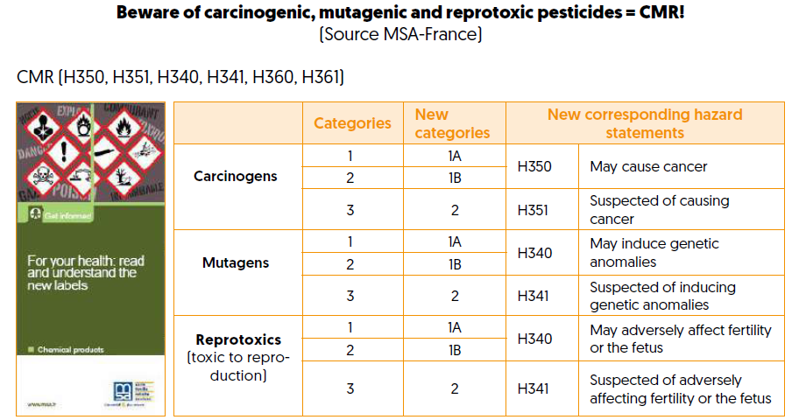
Module 2: Preventing the risks of pesticides - "CMR" pesticides

Slide 8
Module 2: Preventing the risks of pesticides - Reading labels properly
What should be on the label of a pesticide container or bag (synthetic chemicals but also biocontrol products):
The name of the active ingredient contained in the commercial product
Its mode of action
The concentration of the active ingredient(s) in the commercial product
The recommended dose per unit of area and per treatment
The frequency of treatment recommended by the manufacturer
The risk phrases and the lethal dose LD50
The pictograms that specify the types of danger
Waiting times between treatment and harvest or food consumption
The expiration date of the product (=> use before it has lost its effectiveness)

Slide 9
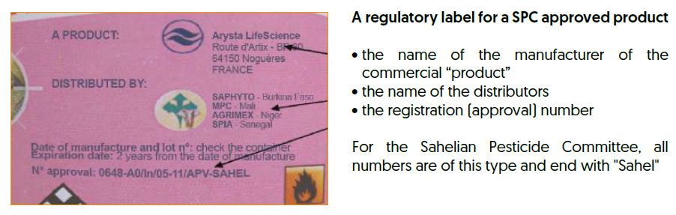
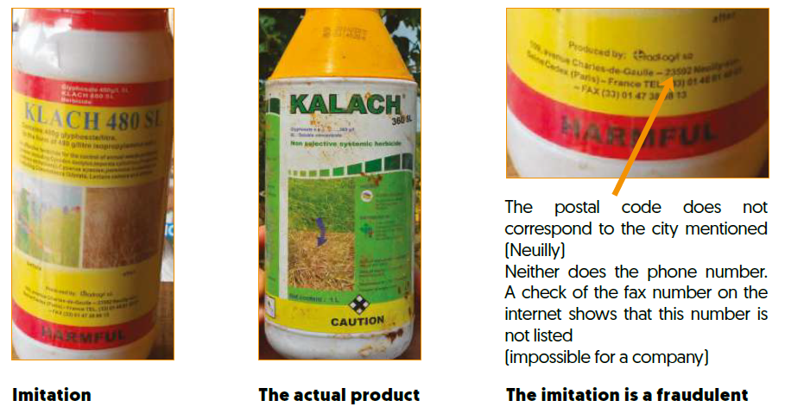
Module 2: Pesticide risk prevention - Identifying fraudulent products
example of counterfeiting and fraudulent marketing practices (RECA Niger)

Slide 10
Module 2: Preventing the risks of pesticides Understanding international conventions - A
Knowing the most dangerous active ingredients prohibited by international conventions
A minimum framework has been put in place by widely ratified international conventions. Conventions are international agreements signed by several states or lists that are scientifically recognized and agreed upon. We distinguish:
The Stockholm Convention: the POP list “Persistent Organic Pollutants” dated 2006.
The Rotterdam Convention: the PIC list "Prior Informed Consent" dating back to 2004 and initiated by the United Nations Environment Programme.
The Montreal Protocol, dating back to 1987 for the protection of the ozone layer.
The PAN list (Pesticide Action Network) 12, dating back to 2011 including a list of the 18 most dangerous compounds used in agriculture.
The WHO lists 1a and WHO 1b: these two lists classify extremely hazardous compounds (1a)
and highly hazardous (1b) to health. It was established by the WHO, the World Health Organization. It dates back to 2007.
All the active ingredients listed by these conventions are specified in Appendix 1.

Slide 11
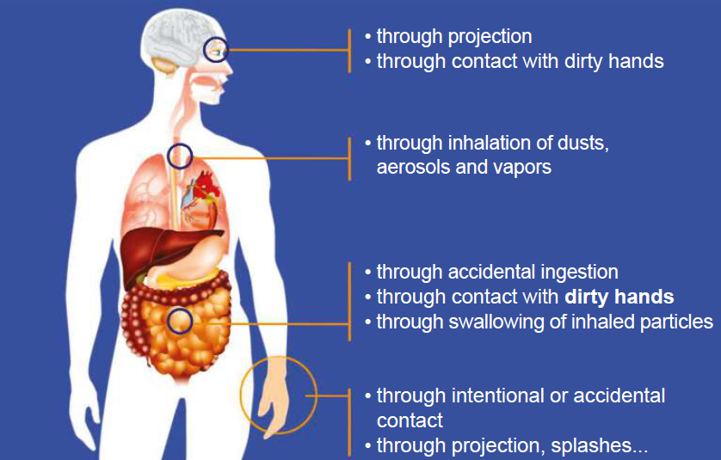
Module 2: Prevention of pesticide risks - Pesticide penetration routes
Theme 2: Understanding the main ways in which pesticides penetrate living organisms and how they evolve along food chains. From this, deduce the priorities in terms of personal protection, how and where products are stored and how their packaging is managed.

Slide 12
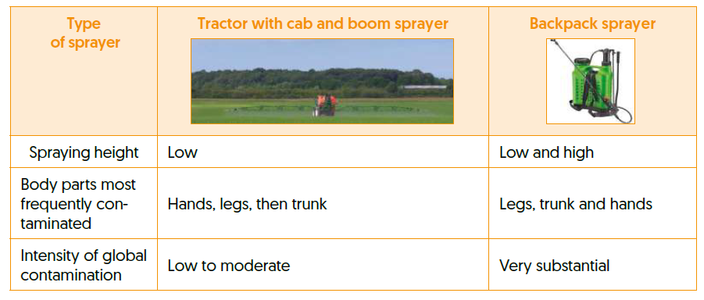
Module 2: Pesticide risk prevention - Personal protective equipment (PPE)
Theme 3: Identifying the body protection equipment available in the region, with its benefits, limitations and even the risks presented by certain equipment under farming and tropical conditions. Identifying ways of facilitating farmers' access to certain equipment.

Slide 13
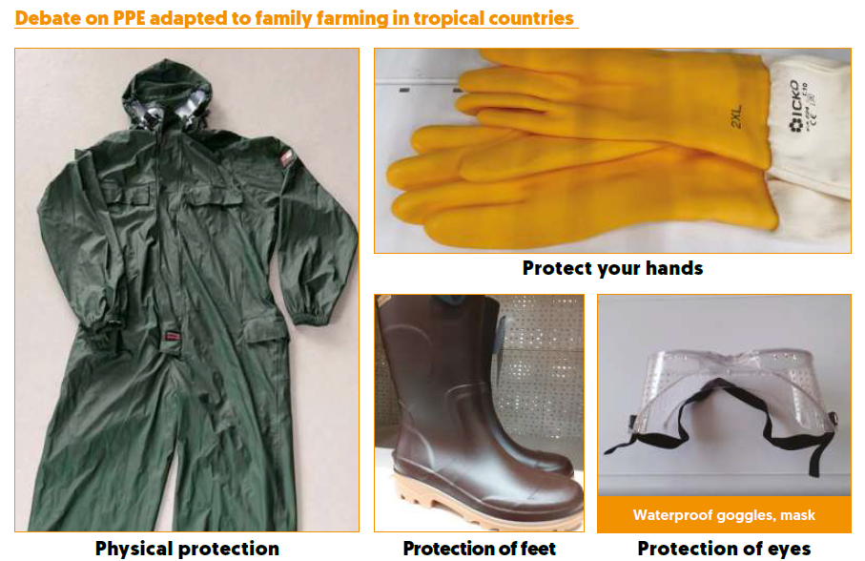
Module 2: Preventing the risks of pesticides - To protect oneself or not?
Protection is necessary, but often insufficient. The best thing is to avoid pesticides
the most toxic (including CMRs).

Slide 14
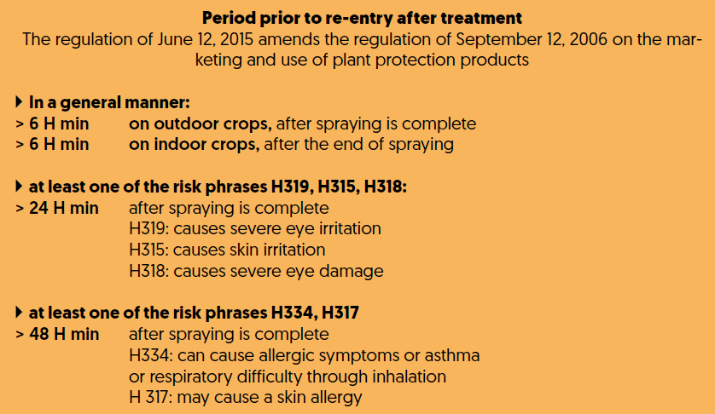
Module 2: Preventing the risks of pesticides - Protecting farmers and their employees
Discussions on the ease of access and the benefits of various body protections for participants.
What are the most easily accessible and useful body protections?
Deadlines for re-entry into plots after treatment. Do you know what they are and are they respected? (below, French legislation for pesticides, minimum time in hours)

Slide 15
Module 2: Preventing the risks of pesticides "What if you have to use a chemical product?
Theme 4: When attacks by insects, diseases, etc. are serious and there are no effective alternative solutions yet, identify the least toxic pesticides and use them more effectively by reducing the risks and adjusting the doses appropriately.
Taking into account the toxicity of products, make substitutions between chemicals to reduce health and environmental risks (for example, eliminate CMR pesticides, which can be identified by the CLP classification on labels, the main risks or hazard statements being H350, H351; H360, H361 and H340 and 341).
Identify the conditions under which pesticides (or biopesticides) can be applied, which often makes it possible to significantly reduce the doses and risks for those carrying out the treatments.
Taking into account the mode of action of the products (chemical or natural), identify the mistakes to be avoided when applying them (see appendix 8 of the guide).
To facilitate the efficacy and penetration of the products, it is preferable not to spray when it is very hot, so treatments should be carried out in the evening or very early in the morning. However, this presents risks for bees and other auxiliary insects, which will drink in the dew present on the plants at sunrise.
Depending on the products and active ingredients present in the intervention zone, well-illustrated advice sheets can be drawn up for farmers, particularly for the active ingredients of least concern.

Slide 16
Module 2: Pesticide risk prevention - Packaging management
Theme 5: List village practices in terms of managing pesticide packaging. Identify the improvements that can be made, whether or not in partnership with input sellers, POs and village and communal authorities who are aware of these issues.
=> What are your reactions to the photos below? Is this your reality? What can you do about it?

