Slide 1
Module 3: Alternatives to pesticides

Slide 2
MODULE 3: PROMOTING ALTERNATIVES TO PESTICIDES
Educational aim: Learn how to identify insects and diseases, better prevent their development and propose alternatives to pesticides that are less harmful to humans and the environment.
Theme 1: Identifying concrete examples in village areas of the negative impact of pesticides on cultivated and non-cultivated biodiversity
Theme 2: Working with participants in their village areas to identify the crop pests causing the problems mentioned in the surveys carried out in Module 1, as well as the auxiliaries and endogenous solutions that can help solve these problems.
Theme 3: Identify and implement ecological transitions to minimise the use of pesticides.
Theme 4: Identifying and promoting biological control methods that can be used by farmers in Africa and other tropical countries (11 examples).
Theme 5: Improve and increase local production of biopesticides and natural preparations of low concern (PNPP).

Slide 3
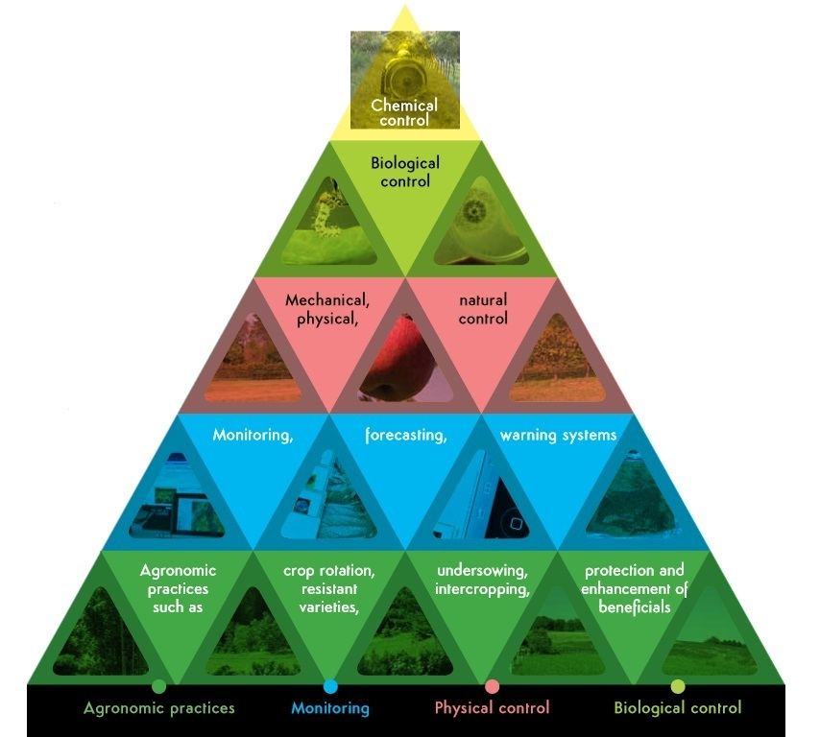
Module 3: Alternatives to pesticides
The basic principles :
As a last resort and with all necessary precautions: chemical intervention
Decision to intervene directly by natural leverage on a target
Diagnosis
Avoidance strategy

Slide 4
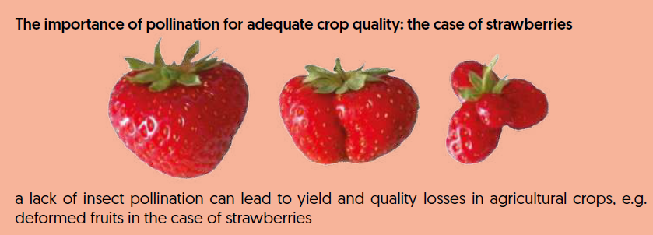
Module 3: Alternatives to pesticides
Theme 1: Identifying concrete examples in village areas of the negative impact of pesticides on cultivated and non-cultivated biodiversity
Pesticides can be very effective against a pest or disease. On the other hand, it is essential to stress the negative impacts of pesticide use. These can be at different levels:
Health problems: nausea during treatment, illness and sometimes fatal accidents
Animal health problems (water or feed poisoning)
Problems with crops
Mortality of bees and other pollinating insects → beekeepers' comments and/or size and shape of fruit harvested

Slide 5
Module 3: Alternatives to pesticides
Theme 2: Working with participants in their village areas to identify the crop pests causing the problems mentioned in the surveys carried out in Module 1, as well as the auxiliaries and endogenous solutions that can help solve these problems.
Knowledge of pests and diseases to arrive at the right diagnosis
You need to identify the pests to be able to deal with them.
1- Identification
2- Knowledge
3- Action levers
For identification purposes, systematically taking photos of the insects encountered is a good habit. Farmers and technicians can also set up a WhatsApp feed or a Facebook page on which they can post photos. The host can help with identification by giving the name and classifying the insect as a pest or a beneficial insect.
How do you identify an insect? You don't need to be an entomologist
Internet, books, social networks, apps: use them all.
Example: What is this animal.com

Slide 6
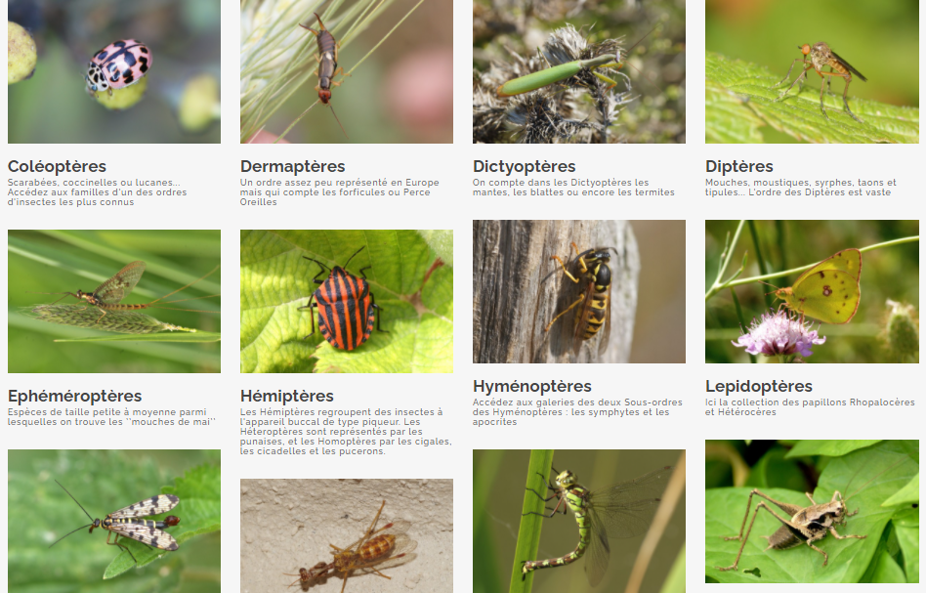
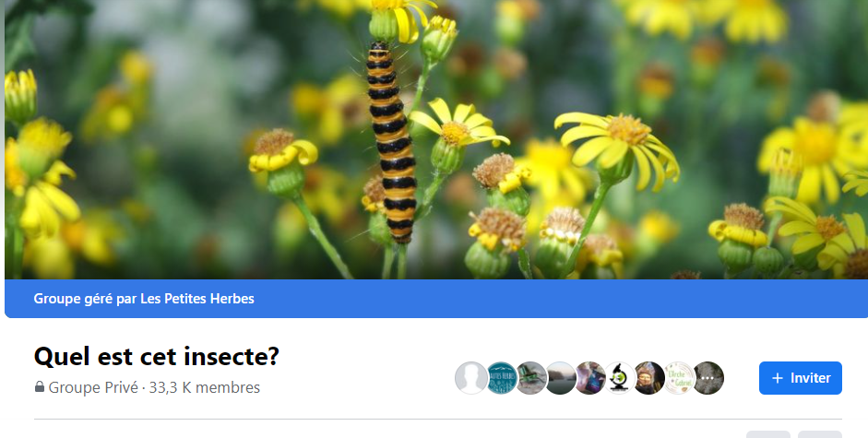
Module 3: Alternatives to pesticides
Theme 2: Working with participants to identify crop pests in their village, ....
Example: What is this animal.com
Example: Facebook group "What is this insect? 33k members. Be careful to respect the group's rules and to find a group that deals with insects in the countries in question.
You can also set up your own Facebook page with local insect experts.

Slide 7
Module 3: Alternatives to pesticides
Theme 2: Working with participants in their village areas to identify the crop pests causing the problems mentioned in the surveys carried out in Module 1, as well as the auxiliaries and endogenous solutions that can help solve these problems.
Once you know the main pests and auxiliaries, you can find out about their life cycle and observe the impact of tests and actions implemented on the balance of populations.
Possible actions - in brief :
Insect pests
Slowing down/reducing populations
Auxiliary insects
Favouring populations
Larval stage → identify living areas and plants needed for growth
Adult stage → identify plants eaten, nesting sites, breeding sites
Egg laying → insect breeding site

Slide 8
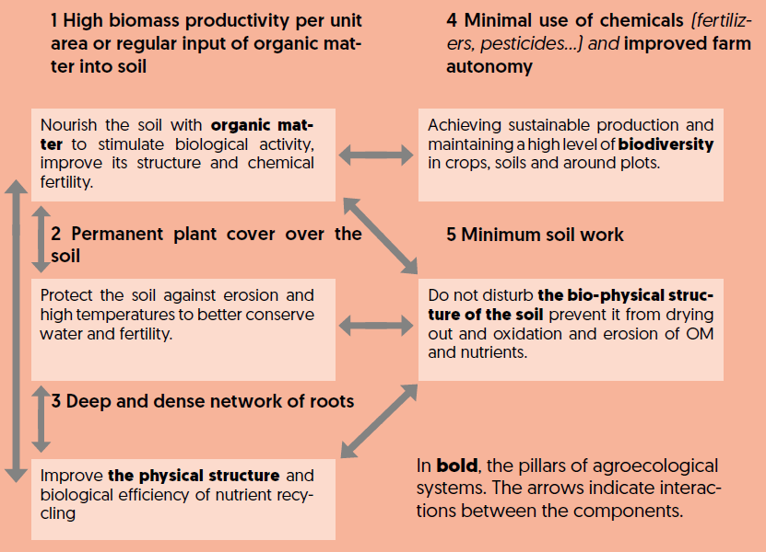
Module 3: Alternatives to pesticides - Theme 3
Theme 3: Identify and implement ecological transitions to minimise the use of pesticides.
Source: the functioning of agroecological systems, (Altieri & Gliessman)

Slide 9
Module 3: Alternatives to pesticides - Theme 3
Theme 3: Identifying and implementing ecological transitions (continued)
Preliminary and preventive measures to reduce risks of attack (diseases, pests) :
Avoid monocultures (long rotations of different species).
Favour varieties that are tolerant to pests and diseases.
Grow mixtures of varieties or mixtures of species with different tolerances to diseases or pests.
Do not sow contaminated seeds or plants - Disinfect crop storage areas and seeds using natural, low-toxicity products (role of ash and certain plants).
To preserve cowpeas, which are attacked by many insects, use triple-bottomed bags.
Encourage areas of refuge and reproduction for birds and beneficial insects and preserve them in the plots.
Remove crop residues from the plot that could contaminate subsequent crops.
Grow trap plants in or around the plot to repel or attract certain pests.

Slide 10
Module 3: Alternatives to pesticides - Theme 3
Theme 3: Identifying and implementing ecological transitions (continued)
Preliminary measures to reduce the pressure of "weeds" penalising crops:
Fairly long rotations with alternating species.
False seeding (when possible...).
A combination of crops that can limit the development of certain weeds.
Other practices :
Collective action against certain pests.
In arboriculture and market gardening, protective netting or use as old mosquito nets against birds and certain insects, ....
Bagging of fruit (banana bunches) or grafts.
Decoys (see the role of scarecrows, but also of scaring hawks and owls).
Various biological control methods mentioned in theme 4 below, taking care to favour those that are accessible and not too costly for farmers.
Etc...

Slide 11
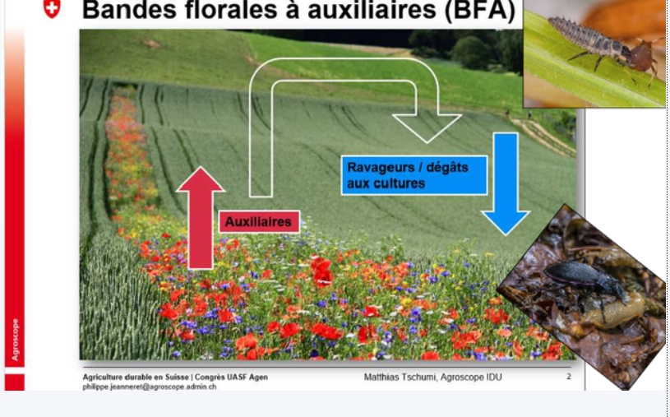
Module 3: Alternatives to pesticides - Theme 3
Theme 3: Identifying and implementing ecological transitions (continued).
Always remember to OBSERVE! Diseases and insect pests can develop very quickly. Their development often depends on a critical stage when they first arrive on a plot.
Encouraging beneficial organisms before pests arrive
Count pests when observed to determine their density and identify a pest threshold
Set up collective monitoring of pests and beneficial organisms
Thinking beyond the plot (crop and landscape diversity, good plot size and organisation, hedges, etc.).

Slide 12
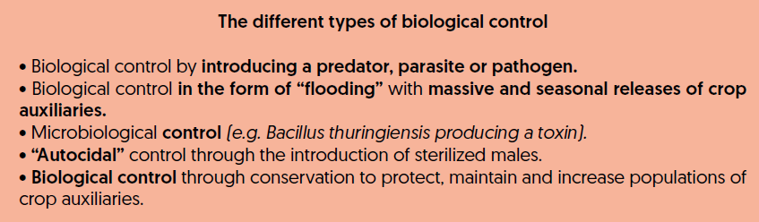
Module 3: Alternatives to pesticides
Theme 4: Identifying and promoting biological control methods that can be used by farmers in Africa and other tropical countries (11 examples).
11 examples are presented in the guide:
- crops featured: maize, sorghum, millet, cotton,
- Methods: based on commercial biological products to be purchased or techniques to be implemented

Slide 13
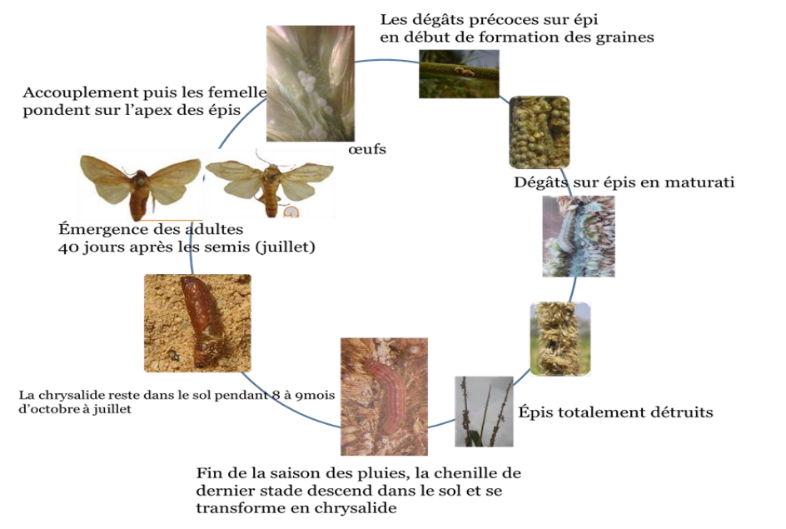
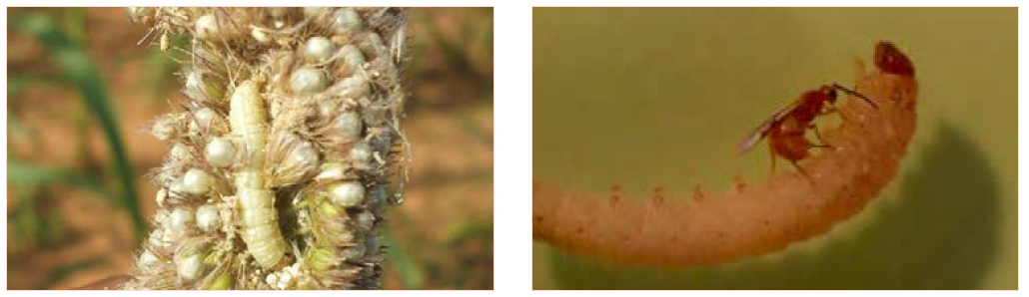
Module 3: Alternatives to pesticides
Theme 4: Identifying and promoting biological control methods that can be used by farmers in Africa and other tropical countries (11 examples).
The example of biological control of the millet leafminer in Niger (by INRAN) using the parasitoid Habrobracon Hebetor Say

Slide 14
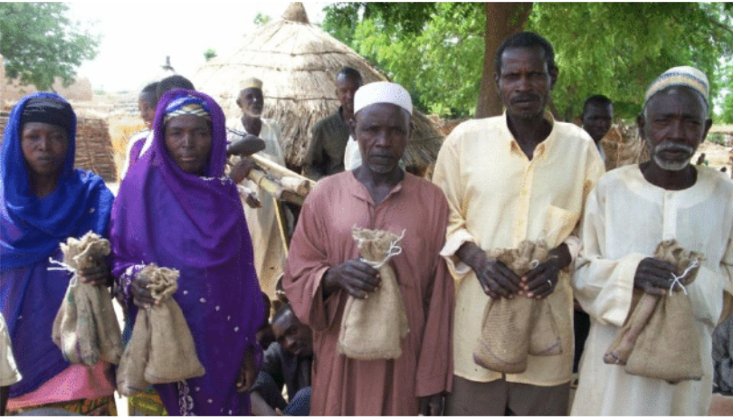
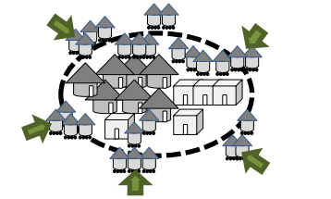
Module 3: Alternatives to pesticides
Theme 4: Identifying and promoting biological control methods that can be used by farmers in Africa and other tropical countries (11 examples).
The example of biological control of the millet leafminer in Niger (by INRAN)
In Niger, breeding of the parasitoid Habrobracon Hebetor Say began in 1998, and work carried out in the INRAN laboratory has shown that a jute sack measuring 15cm x 25cm into which 500g of millet, 50 larvae of Corcyra cephalonica and 5 fertilised females of H. hebetor have been placed can release almost 200 adults of the parasitoid over a period of 2 weeks. This technology was successfully tested in 383 villages in Niger, Burkina Faso and Mali between 2006 and 2008.
Directions for placing insect release bags around the village

Slide 15
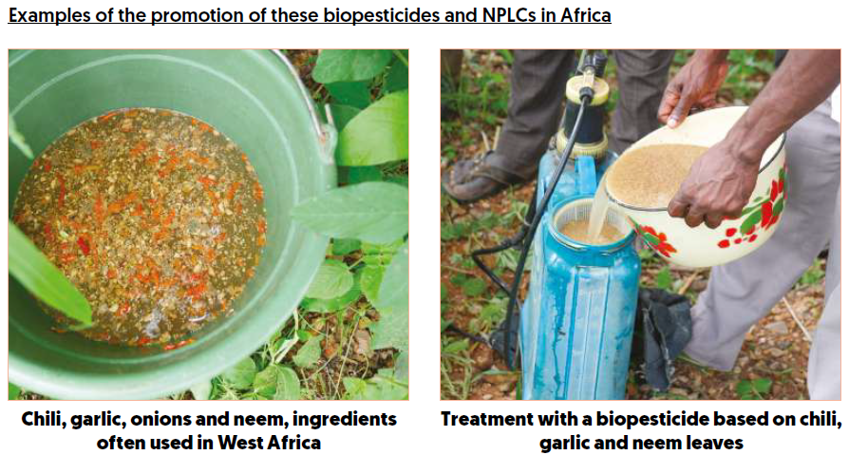

Module 3: Alternatives to pesticides
Theme 5: Improve and increase local production of biopesticides and natural preparations of low concern (NPLC).
This involves using treatments based on natural preparations known to be effective against a pest (repelling it, killing it, strengthening plant defences, etc.).
However, be careful: some natural preparations with a high concentration of active ingredients can be toxic to humans and animals (e.g. tobacco, neem oil, certain mushrooms, etc.).
It is for this reason that a distinction should be made between biopesticides and NPLCs.
For biopesticide-based preparations, handling and spraying should always be carried out with care and body protection. This is all too rarely the case!

Slide 16
Module 3: Alternatives to pesticides
Theme 5: Improve and increase local production of biopesticides and natural preparations of low concern (NPLC).
Biopesticides and NPLCs must be prepared taking into account the raw materials available locally, the working time required, the cost of preparation (with and without family labour) and the practical methods of application.
There is no single recipe that works for all pests, on all crops and in all regions.
In partnership with farmers' groups, local knowledge and readily available plants and natural products should therefore be used, followed by simple but rigorous tests of their effectiveness.
In partnership with the NGO Rafia and a regional FO, the Avsf teams in northern Togo have built up references in these areas.
The same goes for Kita's Avsf team and UR-CUMA, although the tests could be more rigorous.

Slide 17
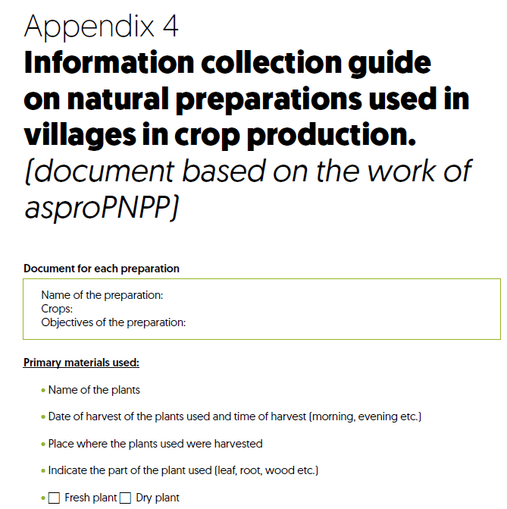
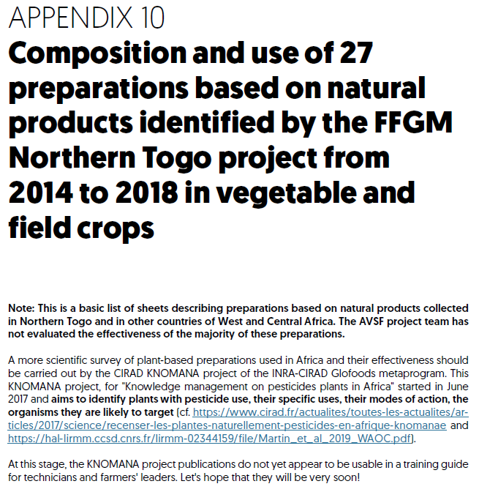
Module 3: Alternatives to pesticides
Theme 5: Improve and increase local production of biopesticides and natural preparations of low concern (PNPP).
Before proposing new natural preparations, make an inventory of existing farming practices and knowledge in the region => See appendices 4 and 10 of the guide below.

