Slide 1
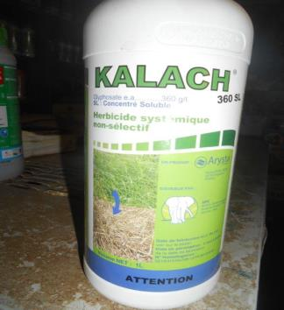
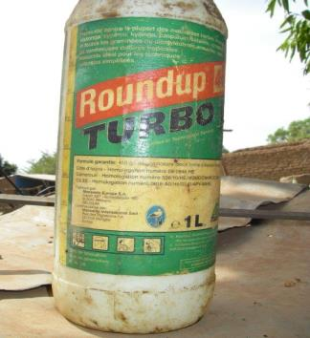
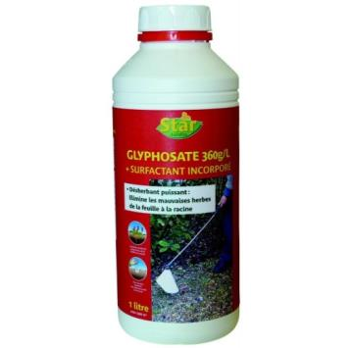
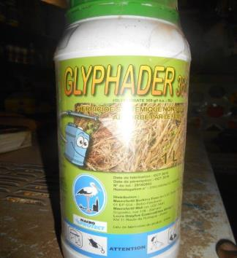
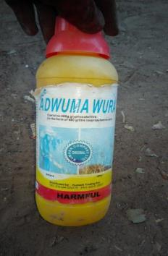
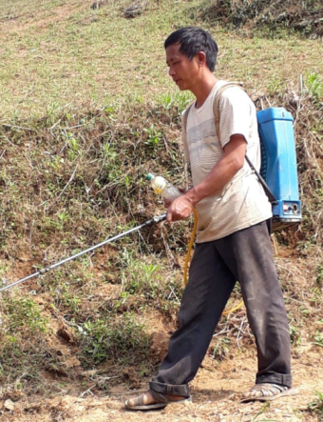
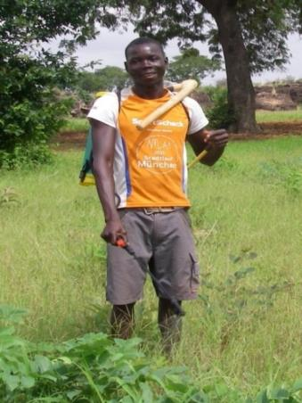
Module 4: Reducing the use of herbicides

Slide 2
Module 4: Reducing herbicides - Teaching objectives and topics
Teaching aim: To be able to propose improvements to farm mechanisation to enable family farms to significantly reduce their use of herbicides.
This module is divided into 4 themes:
Theme 1: Find out about changes in the use of herbicides by farmers in your region.
Theme 2: Find out how the use of animal traction (AT)/ animal-drawn equipment has evolved in your region and identify the problems encountered in terms of equipment maintenance and renewal. Is animal traction effective for weed control?
Theme 3: Analysing the alternatives to AT offered to farmers by governments and other players.
Theme 4: Identify and promote mechanisation options to reduce the use of herbicides.
Suggested teaching method: For each of the themes, an overview of the situation will be proposed, followed by a presentation by the participants of the realities in their area of operation. The group will then draw up a summary.

Slide 3
Module 4: Reducing the use of herbicides - Overall findings for discussion
Overall findings corresponding to theme 1 - Example of West Africa
Since the early 2000s, there has been a sharp increase in the use of herbicides in many southern countries (see graph on next slide for West Africa).
In the Sudanian and Guinean zones of AO, herbicides accounted for 62% of the pesticides used in volume in 2015, and their use has become commonplace (in contrast, it is rare in Sahelian zones).
These are often old active ingredients ("fallen into the public domain") whose prices have fallen sharply, such as atrazine, diuron, paraquat, alachlor, metolachlor, glyphosate, etc.
Given their high toxicity, most of these active ingredients have been banned since the early 2000s in many developed countries, including the EU (=> cf. article by Laurence Caramel, Le Monde, 15 November 2019 " Developping coundries becoming a dumping ground for pesticides banned in Europe ").

Slide 4
Module 4: Evolution of pesticide imports in West Africa (FAOSTAT, 2018) - The increase is mainly due to herbicides

Slide 5
Module 4: Reducing the use of herbicides - Overall findings for discussion
Overall findings corresponding to theme 1 - e.g. West Africa (continued)
Many herbicides bought by farmers (markets, local shops) are no longer approved by national or regional authorities (=> clarify the role of the Comité Sahélien des Pesticides = CSP).
Some 'co-formulants' or 'surfactants' in pesticides sold are more toxic than the active ingredients themselves (cf. the toxicity of the 'surfactant' POEA contained in several glyphosate-based herbicides).
Some herbicides (and other pesticides) may be counterfeit and not contain the % active ingredients stated on the labels (see various studies in Niger, Mali, etc.).
While developing countries are increasing their use of old, highly toxic herbicides, organic farming is growing in France, Austria (1/4 of cultivated area) and in many other parts of the world.
It is therefore possible to do without herbicides, at least if you are equipped with high-performance weed control tools => See the last slides in this module 4.

Slide 6
Module 4: Reducing herbicides - Theme 1
Theme 1: Find out about changes in the use of herbicides by farmers in your region.
The global issues summarised in slide 3 vary greatly from one region to another. In order to adapt the training, it is therefore advisable to discuss the following questions with the participants (indicative list):
Does the information on slide 3 reflect your reality?
What are the reasons for the sharp rise in herbicide use in your region?
On which crops are herbicides frequently used and what are the names of the products and the active ingredients most often used (pre-seeding applications; post-seeding and pre-emergence; post-emergence)?
What do women think about the use of these herbicides?
Can they still grow crops together or gather certain edible plants used in cooking or for medicinal purposes?
What impact do these herbicides have on the young trees in the plots?
...

Slide 7
Module 4 - Theme 1: Heavy herbicide use in North Cameroon
Example of North Cameroon: The use of total and selective herbicides improves farmers' incomes and sometimes soil conservation, but for how long?
Background:
Planting cotton competes with sowing and weeding food crops (maize, sorghum, etc.).
Late crop preparation and maintenance = grass cover and ↘yields
attractiveness of herbicides both for SODECOTON and for farmers, the majority of whom have little in the way of AT equipment
Sharp increase in the area under herbicide since 2000 (fall in the price of several herbicides, including glyphosate, paraquat, atrazine and diuron).
The short-term advantages of chemical ploughing over tillage:
Reduced crop establishment time (0.9 days/ha compared with 3 to 4 days/ha for ploughing).
Controlling perennial weeds thanks to glyphosate's systemic mode of action.
On certain types of soil, reducing the risk of erosion.
This technique is often combined with the use of selective herbicides such as atrazine and diuron and/or animal-drawn equipment for weeding and ridging.
Notes:
In North Cameroon, SODECOTON has observed that cotton planting competes with the sowing and weeding of food crops (maize, sorghum, etc.).
Given the lack of AT equipment for most farmers, crop preparation and maintenance operations are carried out late and weediness can affect yields. This explains the attraction of herbicides for both SODECOTON and farmers.
Since prices fell when a number of herbicides, including glyphosate, paraquat, atrazine and diuron, entered the public domain, the area under herbicide has increased (currently some tens of thousands of hectares).
The most common itinerary is "chemical ploughing" (an application of glyphosate replacing ploughing) followed by direct sowing in dead grass.
In the short term, this technique offers undeniable economic advantages:
A reduction in crop establishment time compared with ploughing, which improves labour productivity (0.9 days/ha compared with 3 to 4 days/ha for ploughing).
Control of perennial weeds thanks to glyphosate's systemic mode of action (their elimination would require deep tillage and/or repeated weeding).
On certain types of soil, reducing the risk of erosion.
This technique is often combined with the use of selective herbicides such as atrazine and diuron and/or animal-drawn implements for weeding and ridging.

Slide 8
Module 4: Theme 1: Heavy use of herbicides in North Cameroon (continued)
Why do farmers in northern Cameroon use so many herbicides?
herbicides = "oxen for the poor" → plant in time and cultivate larger areas.
Cost/ha of herbicide treatment less than hiring animal draught team (≈1 third of the cost).
The majority of farmers are aware of the risks associated with the use of herbicides (Olina Bassala et al., 2010 and 2015),
They know how harmful they are to humans.
They also mention their harmfulness to ruminants when they graze on freshly herbicided plots (link with open grazing).
They mention their negative impact on the fertility and flora of the plots ("herbicides impoverish the soil, making it sandy, and resistant weeds appear").
Socio-economic considerations linked to the short-term survival of farmers would therefore outweigh their consideration of the risks mentioned above.
=> What do you think?
Notes:
Why do farmers in northern Cameroon use so many herbicides?
Farmers with little animal traction (which is common in North Cameroon) say that these herbicides are the "oxen of the poor", as they enable them to get the work done on time and cultivate larger areas.
Given the low cost of generic active ingredients, their use costs much less per hectare than hiring a team (probably a third of the cost, which is very important for those who do not have a complete chain of animal traction).
However, according to several surveys (Olina Bassala et al., 2010 and 2015), the vast majority of farmers are aware of the risks associated with the use of herbicides:
They know how harmful they are to humans.
They also mention their harmfulness to ruminants when they graze on freshly herbicided plots (link with grazing).
Many mentioned their negative impact on the fertility and flora of the plots ("herbicides impoverish the soil, making it sandy, and resistant weeds such as Bulbostylis sp., Cyperus rotundus, Commelina forskalaei appear").

Slide 9
Reducing herbicides - Theme 2 The situation of AT in the AO - Reminders
Theme 2: Find out how the use of animal traction has evolved in your region and identify the problems encountered in maintaining and renewing animal traction equipment. Is this AT efficient for weed control?
Reminders:
In the 1960s-90s, government programmes often supported by external aid and certain commodity chains (groundnut and cotton, for example), animal traction (AT) experienced a major boom. In sub-Saharan Africa, it has become dominant in many Sahelian and Sudanian areas.
Under the impetus of innovators such as Jean Nolle, AT tools such as the Houe sine, the Ariana, the Multiculteur, etc. have been widely distributed in sub-Saharan Africa. When the row spacing does not vary too much, these tools allow crops to be hoeed between the rows.
Since the 80s and 90s, as governments withdrew their support for animal traction, this support has diminished and many family farmers now only have the AT equipment that their grandparents already had.
As a result, labour productivity with these tools has stagnated. In terms of weed control, it is often less than half that of the same worker using a backpack sprayer. For example, it is much quicker to apply a total herbicide than to make one or more AT passes before sowing.

Slide 10
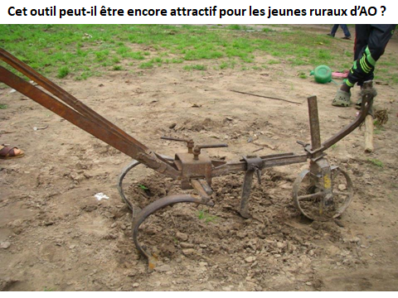
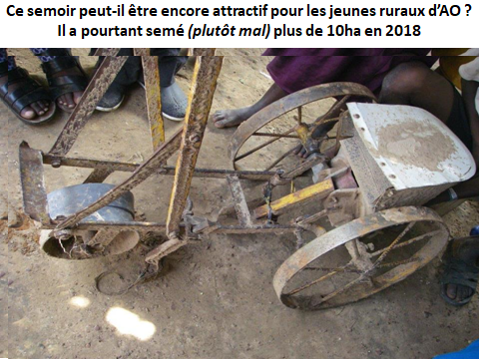
Module 4: Reduction of herbicides - Often deplorable state of MT tools
These 2 photos are from Kita in Mali
(tine tool for weeding and single-row seeder)
Is the condition of AT tools comparable
in your village or small region?
Questions suggested in the slide
will be used to stimulate the debate.

Slide 11
Module 4: Reduction of herbicides - Theme 2 - State of TA: Debate
Following this brief presentation of the overall situation of AT :
Does what is mentioned in the previous slides reflect your reality?
What animals and AT tools do you use most frequently in your home?
What is the nature and condition of the crop hoeing equipment?
What are the main difficulties you encounter in maintaining this AT equipment and acquiring spare parts?
What are the main difficulties in maintaining the animals used for AT?
Do women have access to AT equipment to work their fields? If so, does this access enable them to complete their work on time?
Which AT facilities would be the most motivating to keep young rural people on the land?
What would you like to see in terms of animal traction equipment?
NB: the last 2 questions are important. In many rural areas, many young people are abandoning agricultural activities in favour of gold panning or migration to the towns or even outside the country. Without a sufficient number of motivated young rural people, the future of agriculture is in jeopardy.

Slide 12
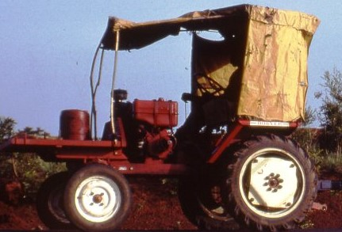
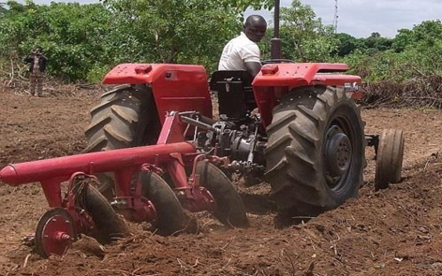
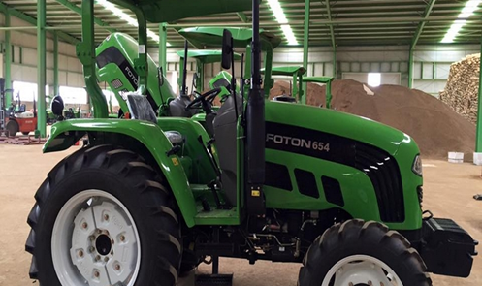
Module 4: Reducing herbicides - Theme 3 - Motorised tillage
The development of motorised tillage is an inescapable reality in many agricultural areas between the tropics.
The photos below mainly concern the Sudanian areas of AO. Tractors were introduced by :
The cotton sectors (see photo below left of a Bouyer single-cylinder tractor - 1990).
Some from AFDI (old but solid tractors from France - 2000s).
Various forms of cooperation (including the Swiss SDC in Benin).
In recent years, several AO governments have promoted subsidised Chinese and Indian tractors.
These tractors are almost always equipped with disc tools and sometimes a trailer. They are managed individually (more than 30,000 in Nigeria) and sometimes in CUMA (North Benin).
The agro-ecological, social and economic results of tractor use seem to be mixed. => What do you think?

Slide 13
Module 4: Reducing herbicides - The authors' view of tractors in AO
The authors' point of view
Often carried out by poorly trained drivers, the use of tractors with disc implements can lead to the following environmental problems:
Risk of increased erosion due to the "spraying" effect and crumbling of the soil caused by the discs, a risk increased by the felling of trees and clearing of plots beforehand to facilitate the use of the tractor.
In plots of annual crops in the Sudano-Sahelian zones of Africa, the negative impact of motorisation on the renewal of useful trees (a driver in a hurry will not see the very young trees, such as karités and nérés, whose non-regeneration is currently a real problem, and will destroy them irreparably).
Destruction by discs of tree and shrub roots, which facilitate the recovery of soil fertility when cultivated plots return to fallow.
Given the lack of multi-row sowing and hoeing tools that can be used with a TA or tractor (see next slide), 'motorised' farmers cultivating large areas often resort to herbicides.
This use of tractors also has worrying social impacts, such as :
1) An increase in the area farmed by those who own tractors and, at the same time, the use of salaried labour for other tasks (=> Patronisation of agriculture).
2) Reduced income for women if trees such as karités and nérés are destroyed.
3) Deforestation increases the time it takes to find firewood.

Slide 14
Theme 4: Identify and promote alternatives to dangerous herbicides and mechanisation options that significantly reduce the use of herbicides - B

Slide 15
Module 4 - Theme 4 - Alternatives What can be done to reduce the use of herbicides in North Cameroon?
Reducing the use of herbicides can only be done in stages, as part of a transition process: → Seeking a compromise, in particular between soil conservation issues and the negative impact on human health and the reduction in biodiversity:
Better reporting and documentation of the risks associated with the widespread use of herbicides:
accidents and chronic health problems
water pollution by herbicide residues
Impact on flora and biodiversity in general (resistance, tree regeneration, etc.)
Offer farmers much less toxic active ingredients and encourage them to pay closer attention to the hazard warnings on the labels of commercial glyphosate-based products (watch out for co-formulants!).
To provide financial assistance to farmers for the purchase of tractor-assisted cultivation equipment (weeders and stubbers) to reduce the use of specific herbicides (see following slides).
Promote cover crop systems (e.g. mucuna, creeping forage cowpea) that are easier to control with little or no herbicide, provided that land tenure and land management are also promoted to regulate grazing rights for agro-pastoralists.
Notes:
In the context of northern Cameroon, as summarised in slides 7 and 8, herbicide use can only be reduced in stages, as part of a transition process and by seeking compromises, particularly between soil conservation issues and the negative impact on human health and the reduction in biodiversity:
Report accidents and chronic health problems, and better document problems of water pollution caused by the spread of herbicide residues, in order to encourage farmers to take greater account of the risks associated with the widespread use of herbicides which, given their high toxicity, are no longer authorised in most developed countries.
Offer farmers much less toxic active ingredients and encourage them to pay closer attention to the hazard warnings on the labels of commercial glyphosate-based products (watch out for co-formulants!).
To provide financial assistance to farmers for the purchase of tractor-assisted cultivation equipment (weeders and stubbers) to reduce the use of specific herbicides (see following slides).
Promote cover crop systems (e.g. mucuna, creeping forage cowpea) that are easier to control with little or no herbicide, provided that land tenure and land management are also promoted to regulate grazing rights for agro-pastoralists.

Slide 16
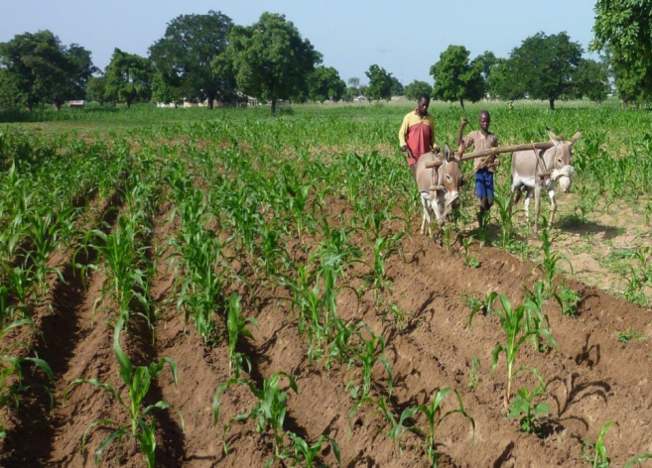
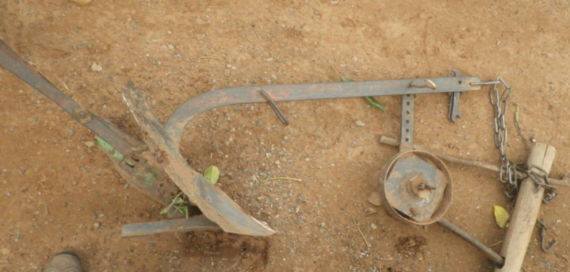
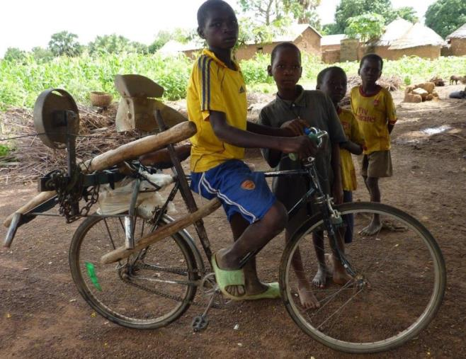
Theme 4 - Alternatives (continued) : Farmers in northern Togo rarely use selective herbicides, but they do use the animal-drawn ridger twice a year.
The ridgeris used to break up the previous year's ridge and build new ridges on which to sow. Then, one or two sarclo-buttages enable weeds to be managed fairly well and selective herbicides to be dispensed with. Depending on the soil, donkeys or oxen are used.
Used in contour lines, it limits erosion.
Local blacksmiths in northern Togo know how to make ridgers that are easy to transport and inexpensive.
However, this tool sometimes works too deeply, diluting the organic matter and causing it to break down too quickly.
Management of the depth control wheel is essential to control working depth.

Slide 17
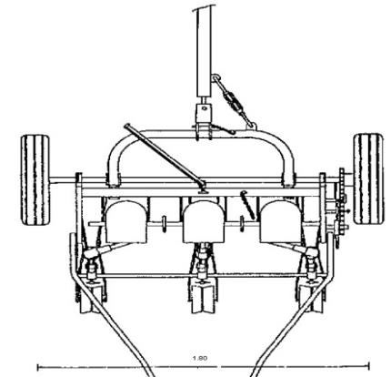
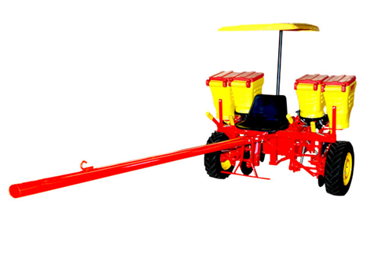
Theme 4: Alternatives: Promoting more efficient mechanical hoeing
The use of multi-row seeders coupled with hoeing equipment with the same spacing enables weeds to be destroyed with a satisfactory level of work productivity that can be competitive with the application of herbicides.
This is the main alternative used worldwide by organic farmers and by those who want to do without herbicides (whether they grow cereals, pulses, or vegetables).
Mechanical hoeing equipment in AT is used in Brazil by small farmers (cf. photo on the right, fitarelli seed drill) and a few years ago in Senegal (diagram on the left showing a polycultivator equipped with 3 rows for groundnuts).

Slide 18
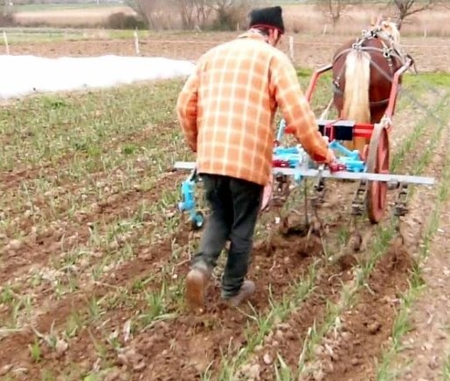
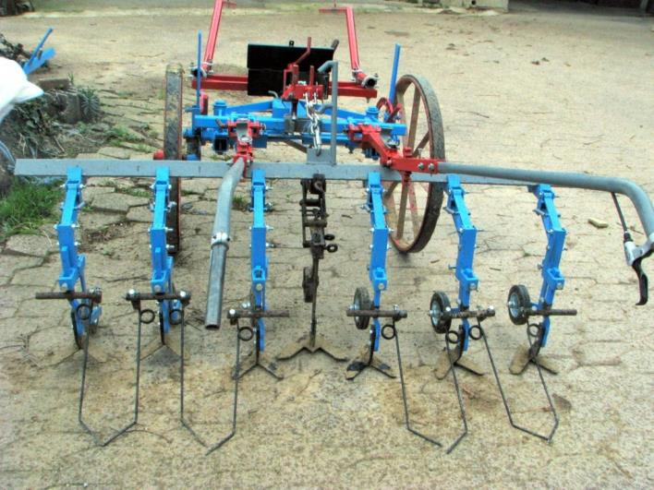
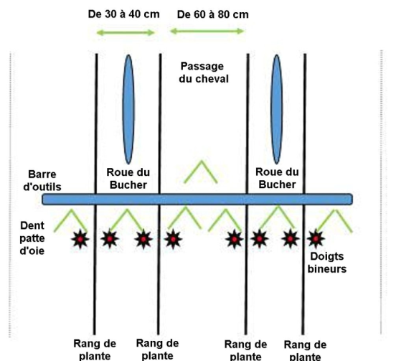
Module 4: - Theme 4: Alternatives: Importance of mechanical hoeing (continued) Source http://hippotese.free.fr/blog/index.php/post/2016/05/11/Binage-multirangs-de-precision-avec-le-NeoBucher
Why do we need constant row spacing?
Hoeing a garlic plot with a NeoBucher
Note that the distance between rows is constant
and that a wider space has been left for the passage
horse. The planting work was therefore very precise.
This equipment is fairly simple and easy to adjust.
You can hoe 4 rows at a time!
=> It is then no longer necessary to use herbicides.

Slide 19
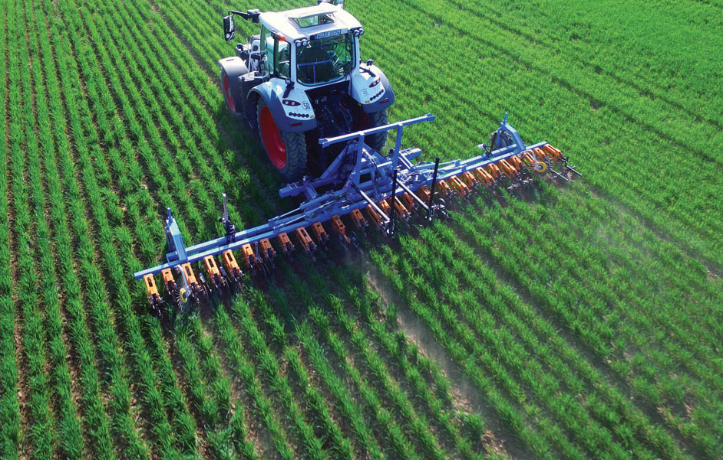
Theme 4: Reducing herbicides in the EU: Weeding wheat with a modern weeder
This laser-guided hoeing machine is used to hoe 26 rows of wheat that have been sown by a drill also equipped with 26 seedbeds of constant spacing (except for
tractor wheel arches). So herbicides are not inevitable!
However, the acquisition of such equipment requires government support (subsidised loans).

Slide 20
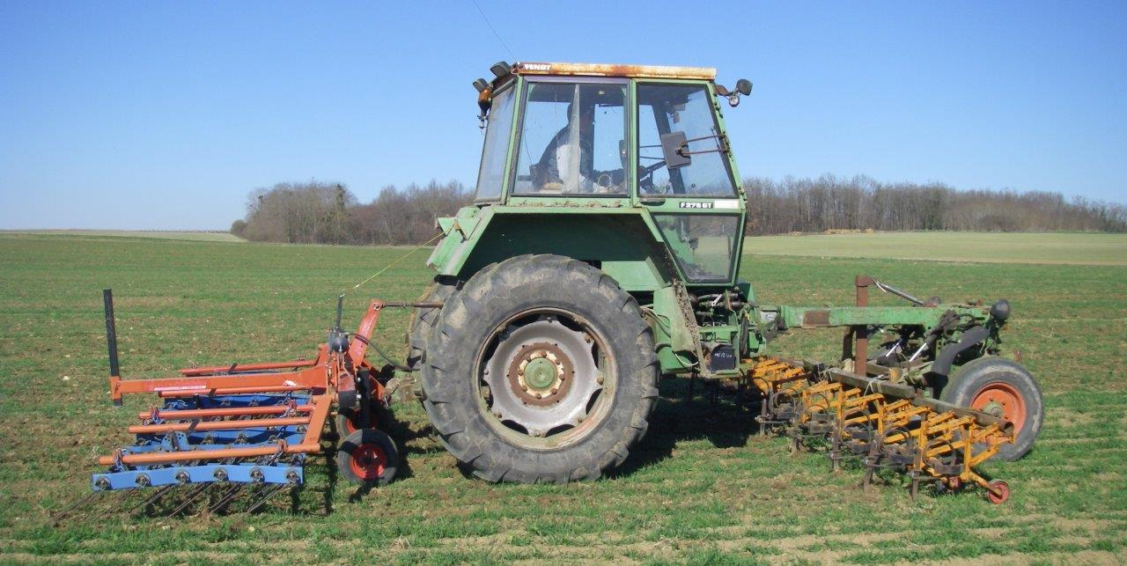
Theme 4: Reducing herbicides in the EU: Weeding barley with 2 tools (J.F. Haulon and V. Beauval's farm in Anjou) - NB: The tractor is 30 years old.
The eye-guided hoe is located between the tractor wheels. It is used to finely hoe 16 rows of wheat, barley or 12 rows of lentils (or 6 rows of maize or sunflower) that have been sown by a drill with the same row spacing. The 4.20 m wide currycomb harrow completes the work of the hoeing machine.
So herbicides are not inevitable!

Slide 21
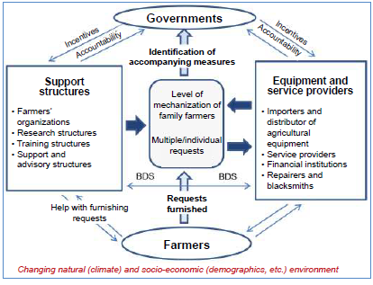
Module 4: Reducing herbicides: Implementing alternatives with strong support from governments and development organisations (source of diagram Havard and Side, 2013)
This scheme lacks access to appropriate credit for the purchase of agricultural equipment.
such as 4-year loans with an interest rate just above inflation.

