Slide 1
Avsf Pesticides Training - Module 5 :
Improving the use of veterinary products

Slide 2
Module 5 - Teaching aim: to be able to prevent the risks associated with the use of veterinary products, and to recommend breeding practices and ethno-veterinary treatments to reduce the use of these products in line with the "One Health" approach.
Teaching guide: For this module, it is important to draw on the practices and knowledge of the participants and of each "field".
This module comprises 4 themes:
Theme 1: Understanding the types of livestock farming practised by training course participants and their contexts, as well as the main pathologies present in these environments.
Theme 2: Understanding the "One Health" approach and why we need to make better use of antibiotics and anti-parasite products.
Notes:
Teaching tip: the module can be adapted to each context based on the experience of each country.

Slide 3
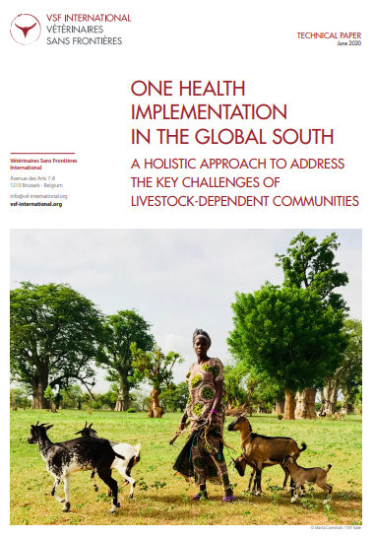
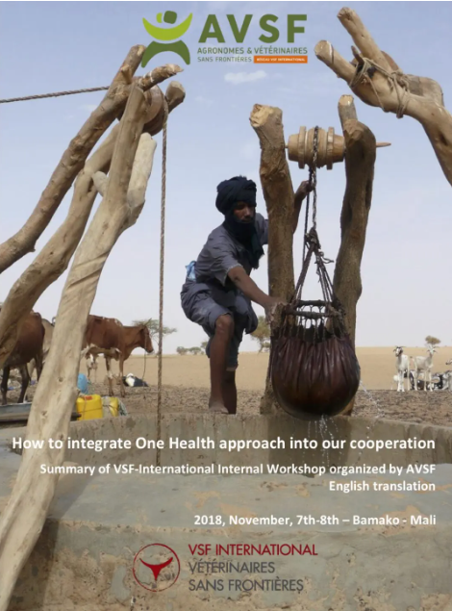
Module 5: Improving the use of veterinary products
Theme 3: Identifying and implementing herd management methods that reduce the need to use veterinary medicines.
Theme 4: Recovering and disseminating relevant traditional (and non-traditional) alternative practices from the areas from which the training participants come.

Slide 4
Module 5: Improving the use of veterinary products
Theme 1: Understanding the types of livestock farming practised by participants in the training courses and their contexts, as well as the main pathologies present in these environments.
Based on the prior participatory diagnosis (see module 1): do farmers have access to veterinary products (antibiotics, anti-parasitics)? If so, how are they used? Identify poor practices (storage, dosage, suitability for diagnosis, compliance with waiting times, waste disposal, etc.);
Where do you buy it, what are the channels, the prices, the quality, the presentation? Do the farmers know how to read and understand a label?
Who are the health professionals in the areas concerned? Vets, ACSA, para-vets?
Are these healthcare professionals involved in the training and can they be mobilised for the activities planned below?

Slide 5
Module 5: Improving the use of veterinary products
Theme 2: Understanding the "One Health" approach and why we need to make better use of antibiotics and anti-parasite products.
Presentation of the One Health approach (integrated, systemic and unified approach to public, animal and environmental health at local, national and global levels). Recall the key themes of the OH approach: antibiotic resistance, zoonoses (avian flu, rabies), etc.
With this approach in mind, why worry about the danger posed by "misused" veterinary products?
  A risk of antibiotic or antiparasitic residues in foodstuffs of animal origin
  The appearance of resistance and therefore a reduction in the effectiveness of treatments
  The release into the environment of product residues which may have a negative impact on the environment
Raise the issue of the quality and availability of veterinary products (remember that in informal channels the percentage of non-compliant veterinary medicines can be high).

Slide 6
Module 5: Improving the use of veterinary products
Theme 2: Understanding the "One Health" approach and why we need to make better use of antibiotics and anti-parasite products.
Possible concrete actions:
  Train professionals and farmers in animal health and good practice in the use of veterinary medicines, by producing accessible training materials (see CEVA example).
  Better individual and collective management of veterinary product waste (bottles, injection equipment) to limit spillage and cross-contamination between animals, etc.
  Advancing alternatives based on traditional knowledge and knowledge of phytotherapy and aromatherapy
  Support the official authorities in implementing regulations on controlling the sale of veterinary medicines, support the development of distribution channels for quality medicines to livestock farmers (veterinary depots, etc.) in compliance with regulations and the structuring of the existing animal health network.

Slide 7


Slide 8
Module 5: Improving the use of veterinary products
Theme 3: Identifying and implementing herd management methods that reduce the need to use veterinary medicines.
Can we completely eliminate the use of veto drugs?
But :
  Choose hardy breeds and/or carry out selections based on hardiness and resistance to certain parasites or diseases
  Reduce stress as much as possible by setting up good rearing conditions
  Providing quality food in line with physiological needs
  Develop the animals' natural resistance to parasites through first aid for infants (quality colostrum intake), semi-divagation, grazing animals from a young age, etc.
  Put in place, where appropriate and depending on the context, reasoned vaccination plans and rely on early diagnosis
  Developing and implementing biosecurity measures on livestock farms

Slide 9
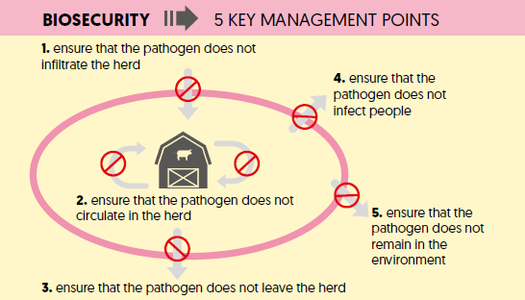
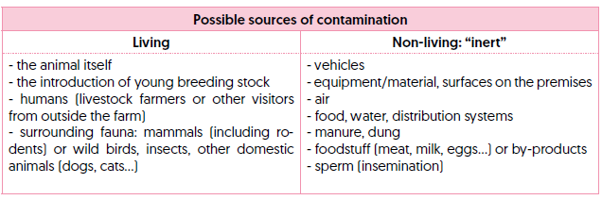

Slide 10
Module 5: Improving the use of veterinary products
Theme 4: Recovering and disseminating traditional alternative practices relevant to the areas from which the training participants come.
Ethnoveterinary practices encompass traditional knowledge and practices for the diagnosis, prevention and treatment of animal diseases.
Most often to strengthen or maintain certain essential physiological functions (immune, digestive, respiratory, locomotor, reproductive, etc.).
This involves the use of medicinal plants or other substances (honey, ash, minerals, etc.) and also zootechnical practices (feeding, choice of breeding stock, etc.).
Useful practices as an alternative to allopathic treatments if the latter are not easily accessible (materially or economically) or used in poor conditions

Slide 11
Module 5: Improving the use of veterinary products
Theme 4: Recovering and disseminating relevant traditional alternative practices in the areas from which the course participants come.
For ethnoveterinary practices, there are both :
  a challenge of collection and conservation
  a validation challenge (for the usual costs and conditions of clinical tests)
  dissemination (by raising awareness among animal health network staff and traditional practitioners)
Ethnoveterinary and allopathic practices can be used in complementary ways depending on the situation (e.g. allopathy for acute pathologies).
"natural" preparation = no toxicity risks? No (e.g. Ricinus communis in Ethiopia, or Catharanthus roseus in Madagascar, vincristine used as a chemotherapy treatment).
Beware also of the origin of the plants (which may contain other biological or chemical contaminants, such as pesticides).
Notes:
The question of the 'scientific' validation of phytotherapeutic practices and recipes remains a delicate one, as the usual conditions for clinical testing of allopathic medicines are ill-suited to this type of practice, which, by definition, has little or no standardisation. As a result, it is difficult to demonstrate the effects of using parts of plants that potentially contain several active ingredients, and whose concentration of active ingredients and efficacy are subject to numerous environmental factors (seasons, preparation method, uncertain dosages due to imprecise measuring instruments, etc.).

